Slide 1
FYP Final Presentation and Demo Communication Protocols in a Digital Twin
Ruazol Armel Paolo Dela Torre
1901396
5th August 2022

Slide 2
Table of Contents
Introduction
Digital Twin
Modbus
IEC 104
Digital Twin Overview
Modbus in the Digital Twin
Future Work
Conclusion

Slide 3
Project Objectives
Develop a hybrid digital twin
Implement communication protocols
Prove its reliability and accuracy
Explore the application of the digital twin
Notes:
The objective of this project is to develop a hybrid digital twin that involves the use of software applications like Node-RED and Matlab, and hardware like raspberry pi
I also aim to implement communication protocols within the digital twin while proving its reliability and its application in the industry

Slide 4
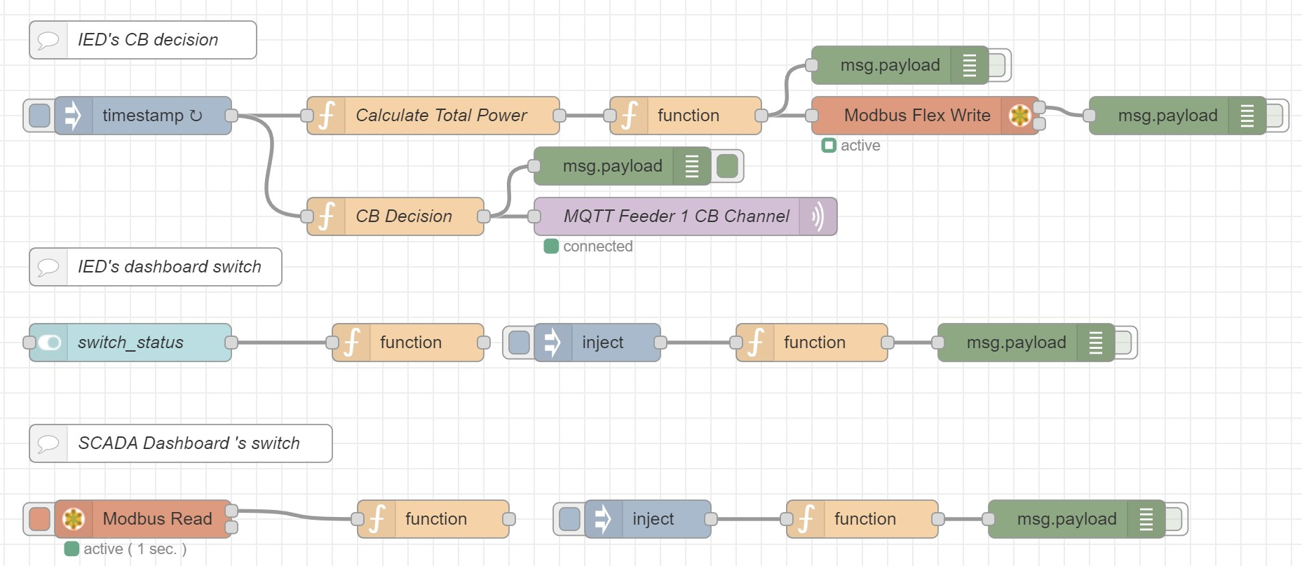
Digital Twin
Representation of a physical system
Provide performance metrics and cybersecurity analysis
Safely experiment and develop solutions
Digital twin done in Node-RED
Notes:
Just to talk briefly about digital twin, it is basically a representation of a physical system like for example a power system or even a vehicle
It is beneficial in a way that it allows performance and cybersecurity analysis and the user can safely experiment and develop multiple solutions without endangering the actual physical system
In our case, the digital twin is done in Node-RED where we are able to connect multiple software applications and physical devices into a single network

Slide 5
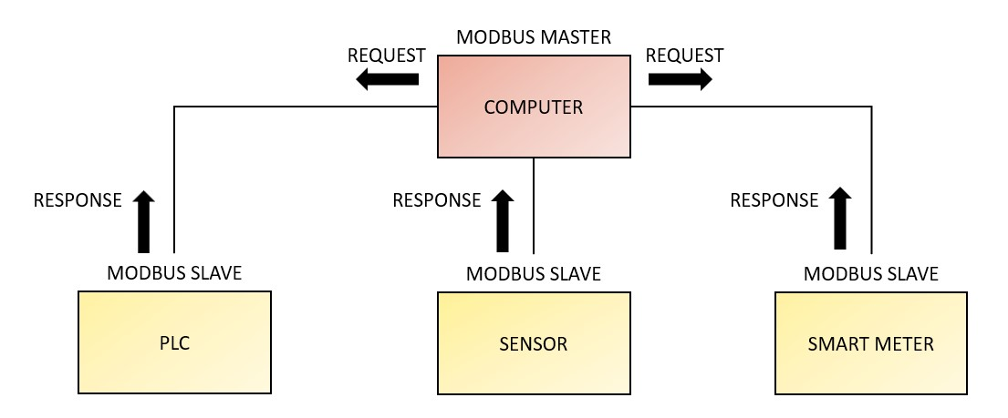
Modbus Protocol
Allows communication between devices within a network
Master and slave devices
Notes:
The first communication protocol I will talk about is the Modbus protocol
To establish a Modbus communication network, we need a combination of two types of devices, a master and a slave
A master device is able to read and write whereas a slave device can only read

Slide 6
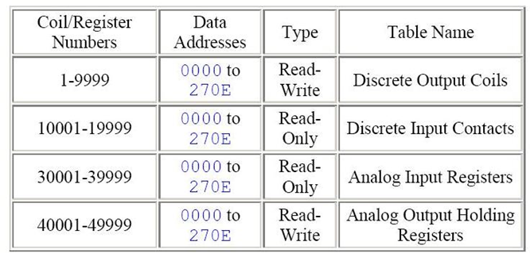
Modbus Protocol
Slave or server stores data on four separate tables
Coils and registers
Coil or registers are referred to as location names
What is Modbus and how does it work?: Schneider Electric USA. www.se.com. (2013, September 3). Retrieved August 3, 2022, from https://www.se.com/us/en/faqs/FA168406/
Notes:
A Modbus slave or server stores data in four separate tables, involving two data types called coils or registers
Only 1-bit data can be stored as coils while 16-bit data are stored as registers

Slide 7
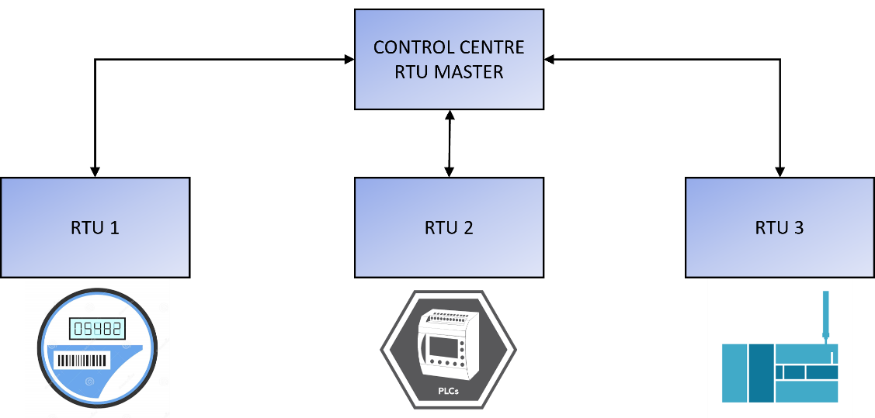
IEC 104
Allows exchange of basic messages between devices within a network
Client-server approach
Supervisory data and acquisition requests
Notes:
IEC 104 is the next communication protocol that I have research and explored its use
Client-server approach
The client sends a general interrogation to the servers, then receives the interrogation feedback along with essential data from the server
For example, a client sends a request for data from a RTU or a sensor, then the sensor sends the essential values to the client

Slide 8
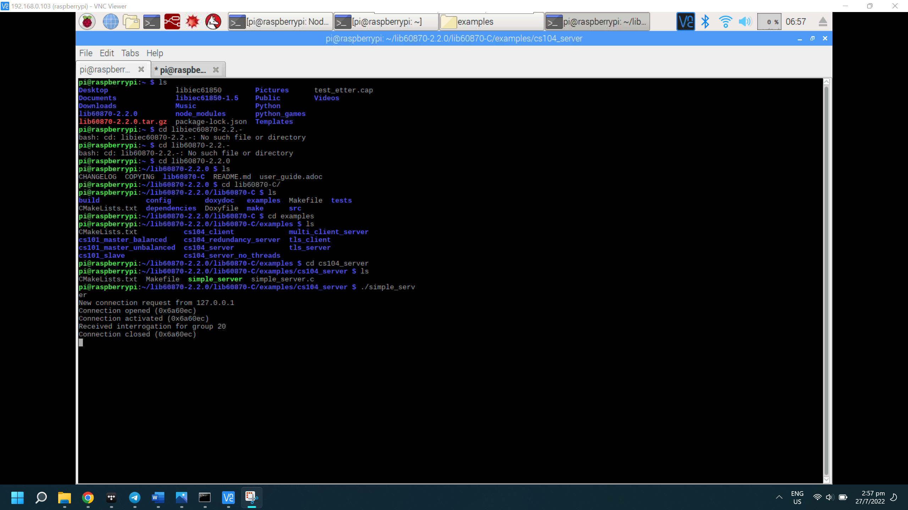
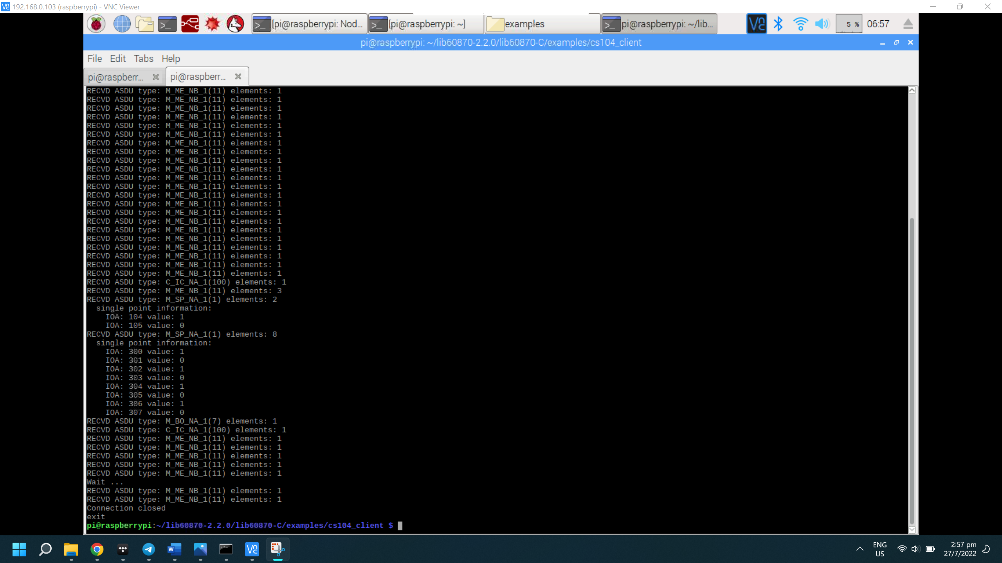
IEC 104
Testing done through C programming files
2 Raspberry Pi devices: Server and client
Server acknowledges client and sends data
Notes:
To explore the use of IEC 104, I did testing through C programming, using multiple raspberry pi devices
One of the pi devices act as the server while the other act as a client
In this example, the server is turned on and waits for the client to request data from it
Once the client is activated and requests data, the server sends that data and the client receives and displays it as shown in the figures

Slide 9
Digital Twin Overview

Slide 10
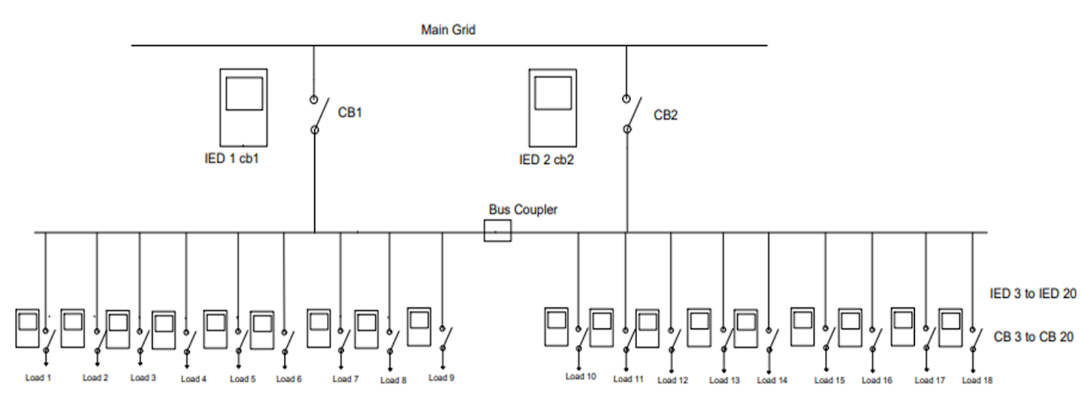
Digital Twin Overview
Distribution Power System
Raspberry Pi devices act as IEDs and SCADA
Notes:
This is actually a representation of a distribution power system, involving the use of IEDs and SCADA through our raspberry pi devices
We have a main grid that supplies two different busbars, which then supplies to nine feeders each
Each feeder represents loads such as residential blocks, commercial and industrial buildings

Slide 11
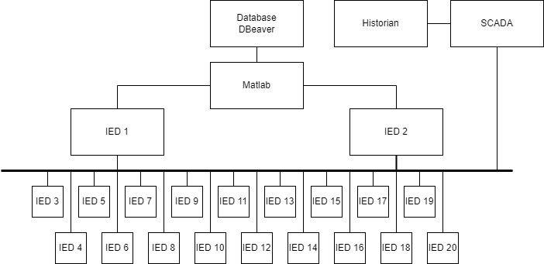
Digital Twin Overview
All IEDs → SCADA
Main IEDs → Feeder IEDs
Notes:
Since we do not have a Matlab model to generate values for the digital twin, we use a database software where we input values such as voltage and current
We developed a Matlab code to retrieve those values and send them to the digital twin through MQTT communication which Darren will talk about later on
The main IEDs in the digital twin then transmit values to the feeder IEDs and all IEDs will than transmit these values to SCADA, all these done through Modbus communication
All IEDs and SCADA have a dashboard for displaying the values while having circuit breaker functions for when the values exceed the threshold

Slide 12
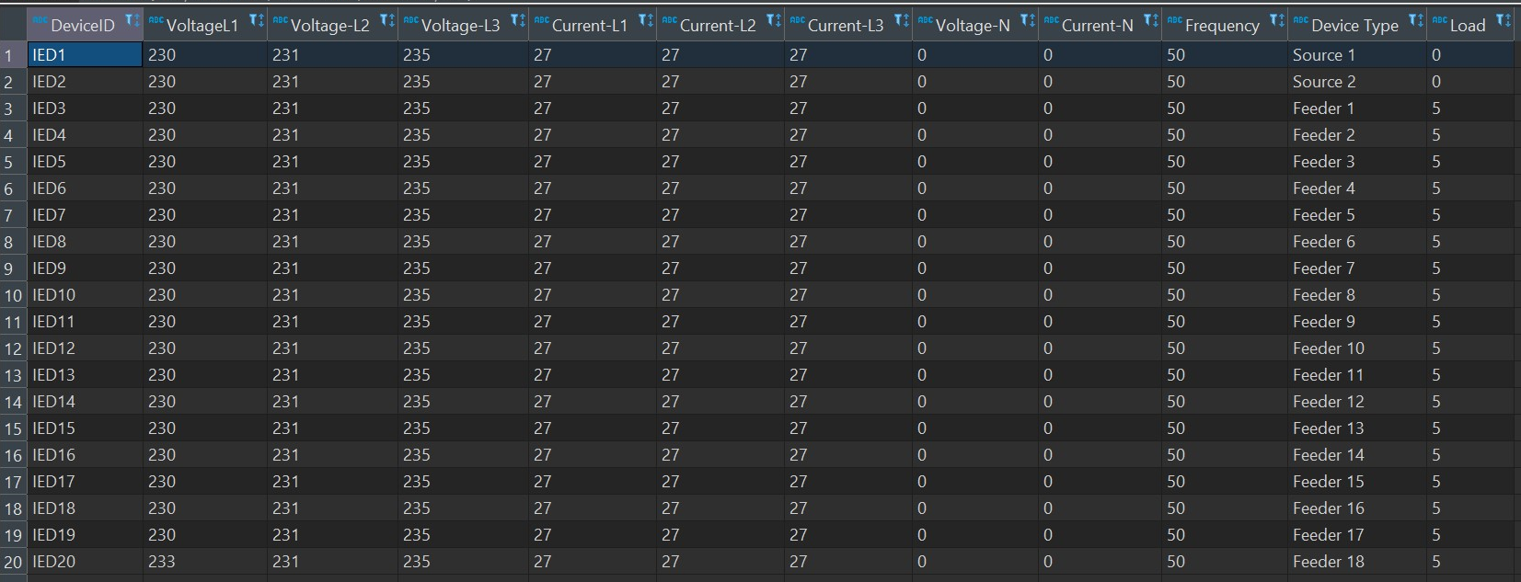
Database
DBeaver software
Database of hardcoded values
Values retrieved through Matlab program

Slide 13
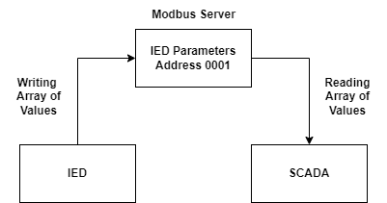
Modbus in Digital Twin – IED to SCADA
All IEDs sends operating parameters to SCADA
E.g., voltage, current, frequency
Notes:
One use of Modbus in the digital twin is the communication from the IEDs to SCADA, sending SCADA their operating parameters for monitoring
The figure below shows an example of how data is being sent through Modbus

Slide 14
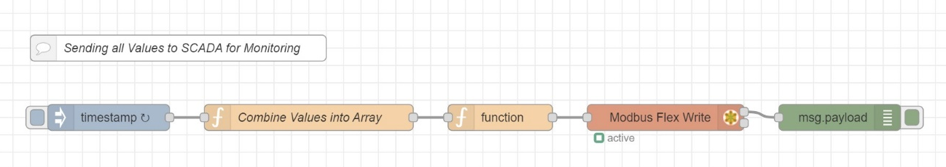
IED to SCADA
Node-RED Modbus write node
Sends an array to a Modbus address
SCADA reads the data within that Modbus address
Notes:
This is an example of how data is being sent through Modbus in Node-RED through the Modbus write node
The values are combined into an array and is then stored into the server through a Modbus write node

Slide 15
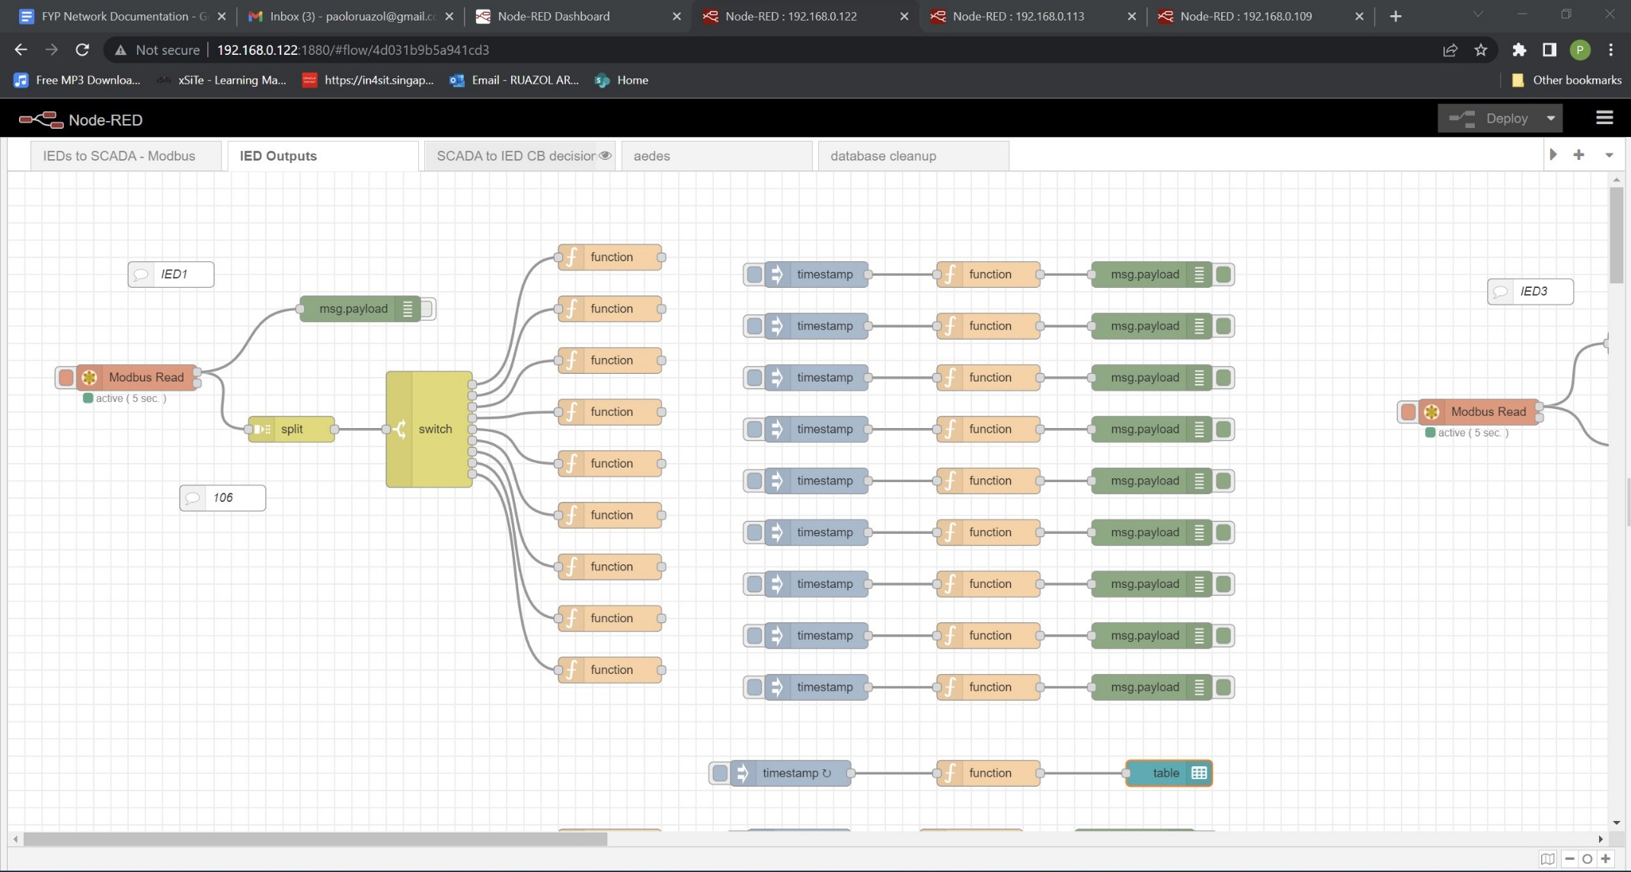
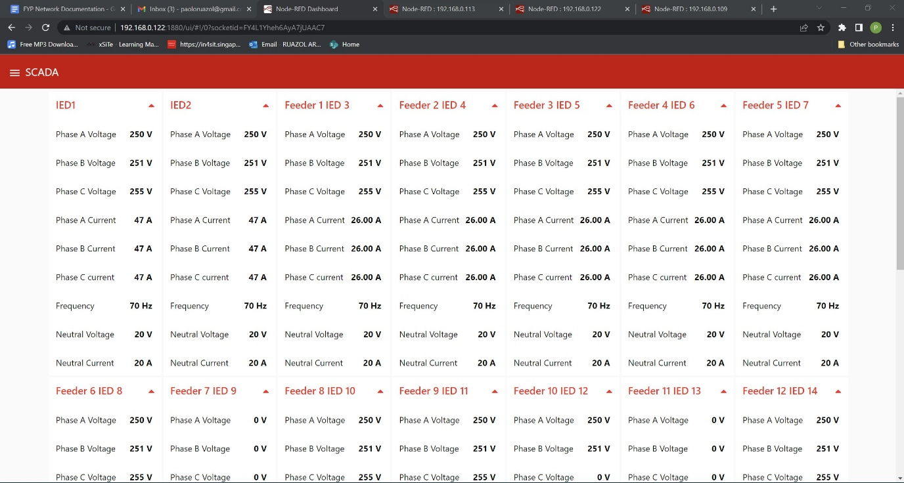
IED to SCADA
SCADA reads the data within that Modbus address
Each value is then displayed onto a dashboard
Notes:
SCADA then reads the data stored in the respective address, retrieves the data and displays them on a dashboard

Slide 16
Future Work
Implement other communication protocols, e.g. IEC 104
Testing cybersecurity vulnerabilities, e.g. Wireshark, Ettercap

Slide 17
Conclusion
Modbus communication in digital twin is reliable and accurate
Easy integration of different software
Fast and accurate data transmission rate

